Slide 1
Data Analysis for Turtle Games
Prepared by: Tuhina Srivastava
Data Analysis 301
LSE
Notes:
Welcome to my presentation on Data Analysis for Turtle Games.
We’ll explore three key areas:
Loyalty Points analysis to understand customer behavior.
Customer Segmentation to target different spending groups.
Sentiment Analysis of reviews to improve satisfaction.
The goal is to provide insights to optimize the loyalty program and boost engagement.

Slide 2
Background/Context of the Business
Turtle Games aims to improve sales and engagement through data analysis
Understanding loyalty points
Segmenting customers
Sentiment analysis of product reviews.
Notes:
Turtle Games is a leading manufacturer and retailer of books, toys, and games, serving a global customer base.
In this analysis, we focus on three key objectives:
Understanding Loyalty Points: How customers accumulate loyalty points and what drives their behavior.
Customer Segmentation: Identifying different customer groups based on spending habits and remuneration to target them effectively.
Sentiment Analysis: Evaluating product reviews to understand customer satisfaction, key pain points, and areas for improvement.
By addressing these objectives, we aim to enhance customer engagement, optimize the loyalty program, and drive better business performance through data-driven insights.

Slide 3
Analytical Approach
Data Import and Cleaning
EDA: Visualisations and statistics
Statistical Modeling: Linear Regression
K-Means Clustering for segmentation
Sentiment Analysis using NLP techniques
Notes:
In this slide, I will walk you through the key analytical steps taken to achieve the project objectives:
Data Cleaning: The raw data was first inspected for missing values, irrelevant columns, and inconsistencies. This ensured a clean and reliable dataset for analysis.
Exploratory Data Analysis (EDA): Using visualizations like scatterplots, histograms, and boxplots, we identified trends, patterns, and outliers to understand the underlying relationships between variables such as Spending Score, Loyalty Points, and Remuneration.
Clustering Analysis: To identify meaningful customer groups, K-means clustering was applied. This allowed us to segment customers into distinct clusters based on their spending behavior and income levels.
Sentiment Analysis: We evaluated product reviews using Natural Language Processing (NLP) techniques to assess overall sentiment. This revealed positive and negative themes, helping identify areas for improvement.
By following these steps, we were able to extract actionable insights that align with Turtle Games' business objectives

Slide 4
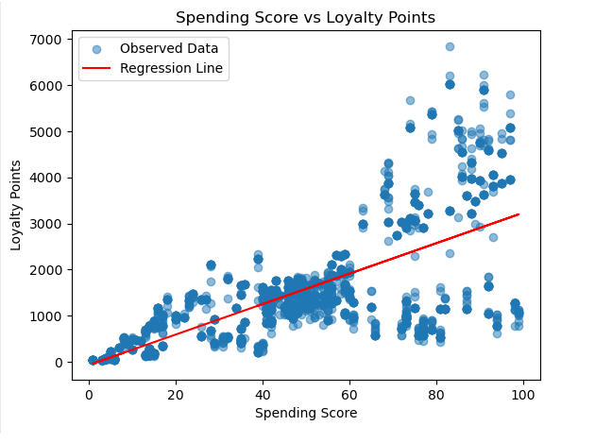
Spending Score vs Loyalty Points
Key Insight:
Positive correlation between Spending Score and Loyalty Points.
High spenders accumulate more points.
Notes:
This scatterplot shows the relationship between Spending Score and Loyalty Points. Notice the clear positive correlation: as the Spending Score increases, Loyalty Points also tend to increase.
This indicates that spending behavior strongly influences loyalty points accumulation. Customers who spend more consistently earn higher loyalty points, making them valuable contributors to the loyalty program.
This insight can help Turtle Games focus on high spenders by offering tailored rewards to further increase engagement and spending.

Slide 5
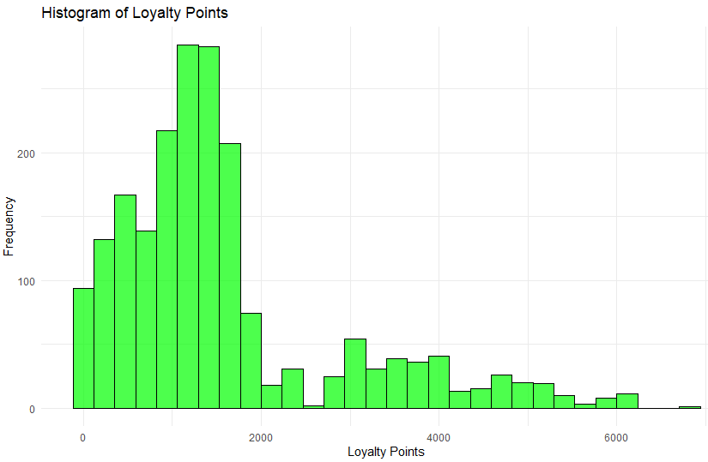
Loyalty Points Distribution
Key Insight:
Loyalty Points are right-skewed.
Most customers accumulate fewer than 2,000 points.
Notes:
This histogram shows the distribution of Loyalty Points across all customers. The data is right-skewed, meaning most customers accumulate fewer than 2,000 points.
However, there is a small group of high-value customers on the right side of the chart who have earned significantly higher loyalty points. These customers represent an opportunity for Turtle Games to focus their loyalty program efforts, such as offering exclusive rewards or personalized incentives to further engage this valuable segment.
The skewed distribution emphasizes the importance of identifying and targeting these high-value customers to maximize the program's effectiveness.

Slide 6
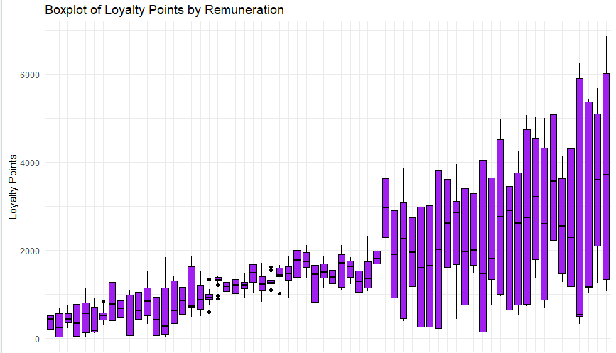
Loyalty Points by Remuneration
Key Insight:
Variability in loyalty points across income levels.
Higher earners accumulate significantly more points.
Notes:
This boxplot shows the relationship between Remuneration and Loyalty Points. You can see a clear trend: customers with higher remuneration tend to accumulate significantly more loyalty points.
The variability within higher income groups highlights an opportunity for Turtle Games to design tiered loyalty rewards. By segmenting customers based on their income levels, the company can offer tailored benefits that encourage greater spending and engagement.
For example, high-income customers could receive premium rewards, while middle and lower-income segments could be incentivized through targeted discounts or bonus points. This approach ensures the loyalty program is both equitable and effective.

Slide 7
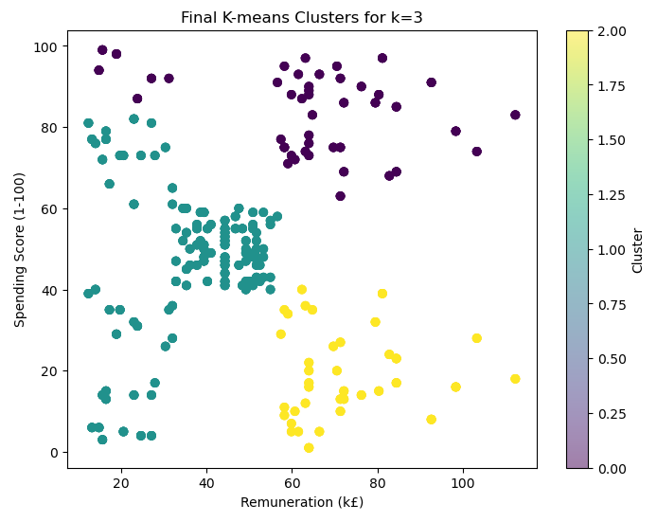

Customer Segmentation (K-Means)
Three clusters identified:
Cluster 1: High spenders, high earners.
Cluster 2: Moderate spenders.
Cluster 3: Low spenders.
Notes:
This diagram represents the results of the K-Means Clustering Analysis, where customers were grouped into three segments based on their Spending Score and Remuneration:
Cluster 1: High spenders with high remuneration. These customers are the most valuable to Turtle Games and should be targeted with premium offers and exclusive benefits to maintain their engagement.
Cluster 2: Moderate spenders with medium remuneration. This group presents an opportunity to incentivize spending through targeted promotions or bonus rewards, encouraging them to move to a higher spending tier.
Cluster 3: Low spenders with low remuneration. For this segment, offering discounts or entry-level rewards can help improve engagement and loyalty.
By understanding these customer segments, Turtle Games can design tailored marketing strategies to address the unique behaviors and needs of each group, maximizing the effectiveness of the loyalty program.

Slide 8
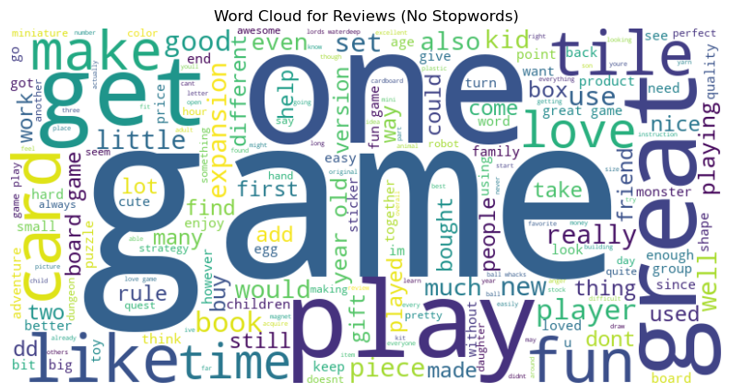
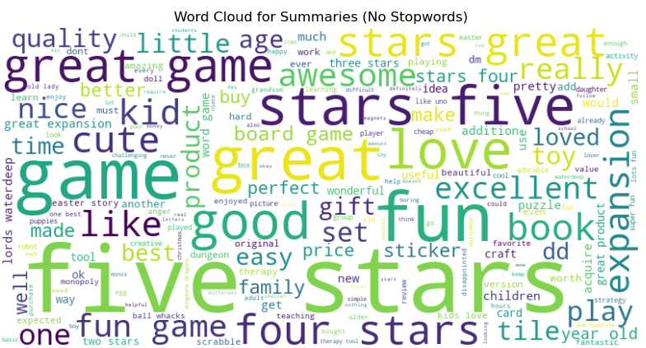
Sentiment Analysis Results
Key Insight:
Product reviews are slightly positive.
Positive themes: product quality, enjoyment.
Negative themes: utility issues.
Notes:
This slide shows the results of the sentiment analysis on product reviews.
The overall sentiment is slightly positive, with most customers praising product quality and overall enjoyment.
However, negative reviews highlight key areas of dissatisfaction, including issues related to utility and product performance.
By addressing these negative themes, Turtle Games can improve customer satisfaction and loyalty. For example:
Resolve product utility concerns by providing clearer descriptions or enhancing functionality.
Strengthen aspects customers appreciate, such as product quality, to reinforce positive experiences.
This targeted approach ensures that Turtle Games not only retains satisfied customers but also converts dissatisfied ones into loyal advocates.

Slide 9
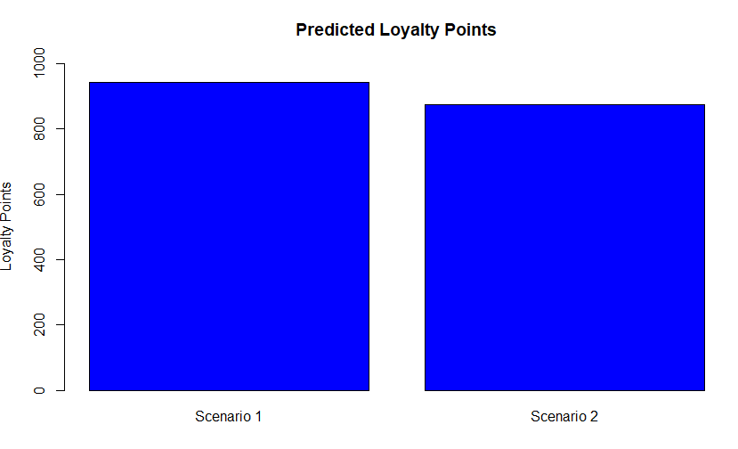
Predicting Loyalty Points
Predicted Scenarios
Two customer scenarios were predicted:
Scenario 1: A customer with a moderate Spending Score and medium Remuneration.
Scenario 2: A customer with a high Spending Score and slightly lower Remuneration.
The bar chart visualizing these predictions demonstrated that Spending Score plays a critical role. Customers with higher spending behavior consistently accumulate more points.
Notes:
This slide highlights the prediction results for Loyalty Points using the Multiple Linear Regression (MLR) model.
The model achieved an R-squared value of 0.85, which indicates a high level of accuracy—85% of the variance in Loyalty Points is explained by Spending Score and Remuneration.
Spending Score emerged as the strongest predictor, showing that higher spending directly leads to more loyalty points.
Remuneration also plays a significant role, indicating that income levels influence loyalty point accumulation.
These reliable predictions align with Turtle Games' business goals by enabling:
Targeted customer strategies for high-value individuals.
Optimized loyalty programs that reward spending behavior and drive engagement.
The insights provided by this model ensure data-driven decisions to enhance customer retention and overall program effectiveness.

Slide 10
Recommendations for Turtle Games
Introduce
Introduce tiered rewards based on Spending Score and Remuneration.
Focus
Focus marketing on high-value customers (Cluster 1).
Address
Address dissatisfaction in reviews to improve customer experience.
Notes:
This slide highlights the actionable recommendations for Turtle Games based on the analysis:
Introduce Tiered Rewards: Develop tiered loyalty programs based on Spending Score and Remuneration. High spenders and high-income customers should receive premium benefits to maintain their engagement.
Targeted Marketing:
Focus marketing efforts on Cluster 1 (high spenders) with exclusive offers.
Incentivize Cluster 2 (moderate spenders) with promotions to increase their spending.
Engage Cluster 3 (low spenders) through discounts or entry-level rewards to drive participation.
Improve Product Satisfaction:
Use sentiment analysis insights to address negative feedback on utility and product performance.
Reinforce positive aspects like product quality that customers already appreciate.
By implementing these recommendations, Turtle Games can enhance customer loyalty, increase sales, and strengthen the overall effectiveness of the loyalty program.

